Slide 1

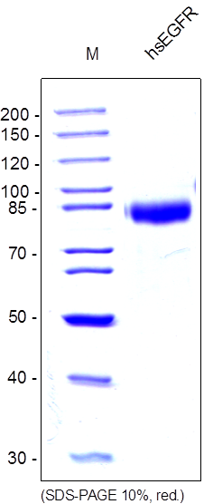
ReliaTech GmbH
Recombinant human soluble EGF receptor
(Cat # S01-040S / S01-040)
Fig. 1: SDS-PAGE analysis of recombinant human soluble EGF receptor produced in insect cells. Sample was loaded in 10% SDS-polyacrylamide gel under reducing conditions and stained with Coomassie blue.
http://www.reliatech.de / orders@reliatech.de

